Slide 1
Data Analysis Project in BigQuery
Denis Storozhuk, AFPA/Data Science programme, July 2023

Slide 2
Stages of the project
Brief / Debriefing
Load, Transform, Export data
EDA (Exploratory Data Analysis)
Modelling
Logistic Regression
Random Forrest Classifier
Deep Neural Networks
Boosted Trees
Hyperparameter Tuning
Summary / Key Learnings

Slide 3
Data Cleaning

Slide 4
Stages of data cleaning
Load data
Transform data
Replace NANs
Check/change datatypes
Replace Zeros with Medians
Drop non-used columns
Ready to export data (e.g. for EDA)

Slide 5
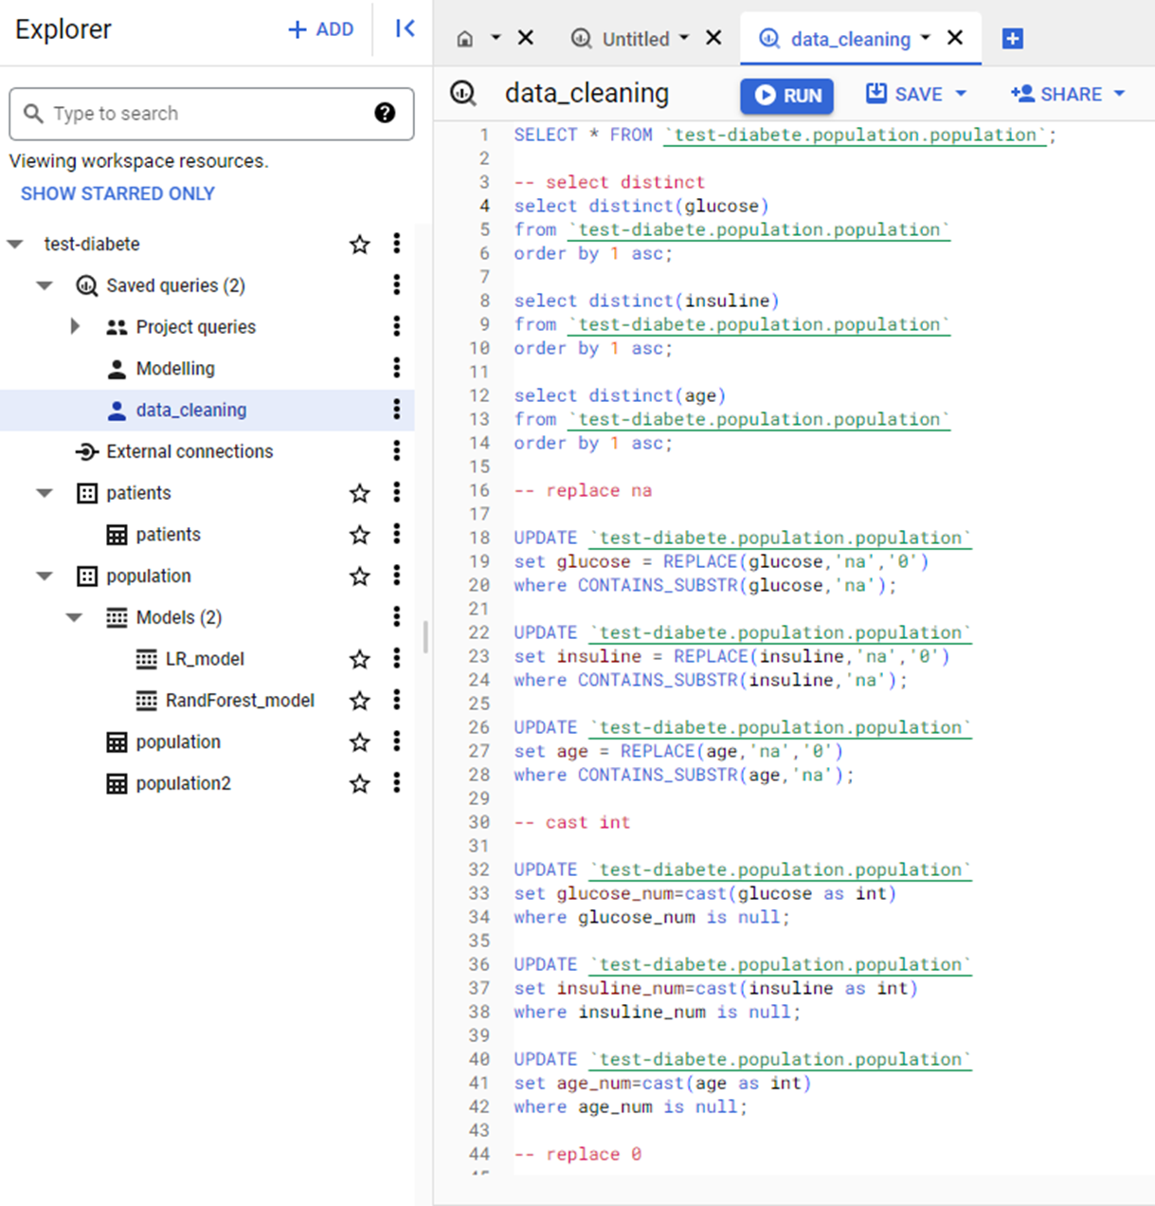
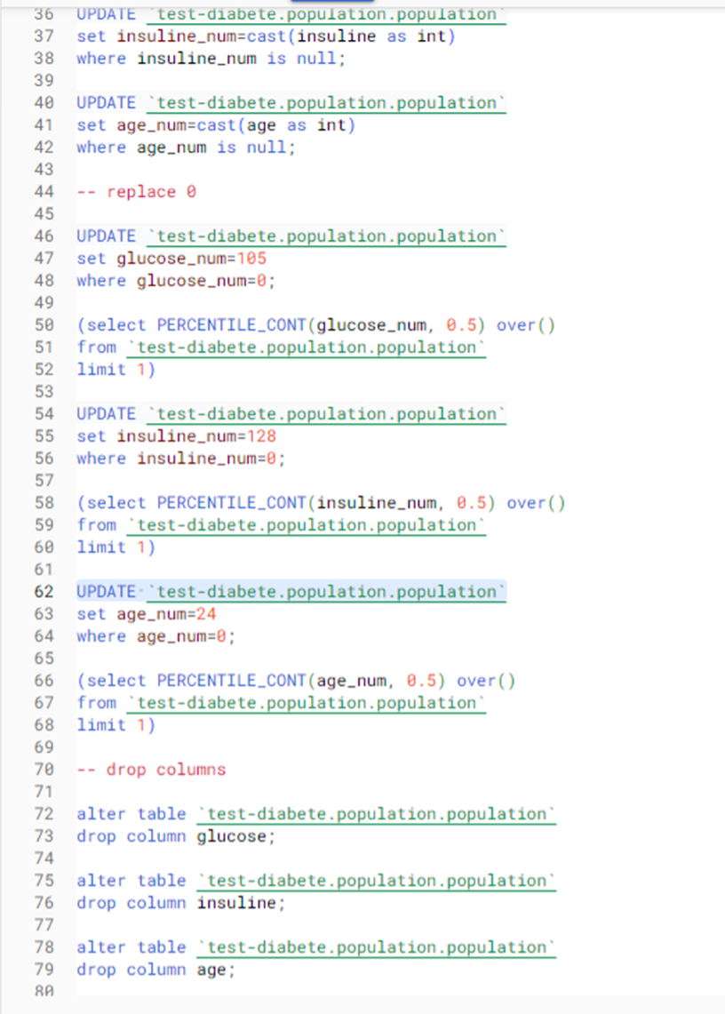
The code in SQL

Slide 6
EDA / Exploratory Data Analysis

Slide 7
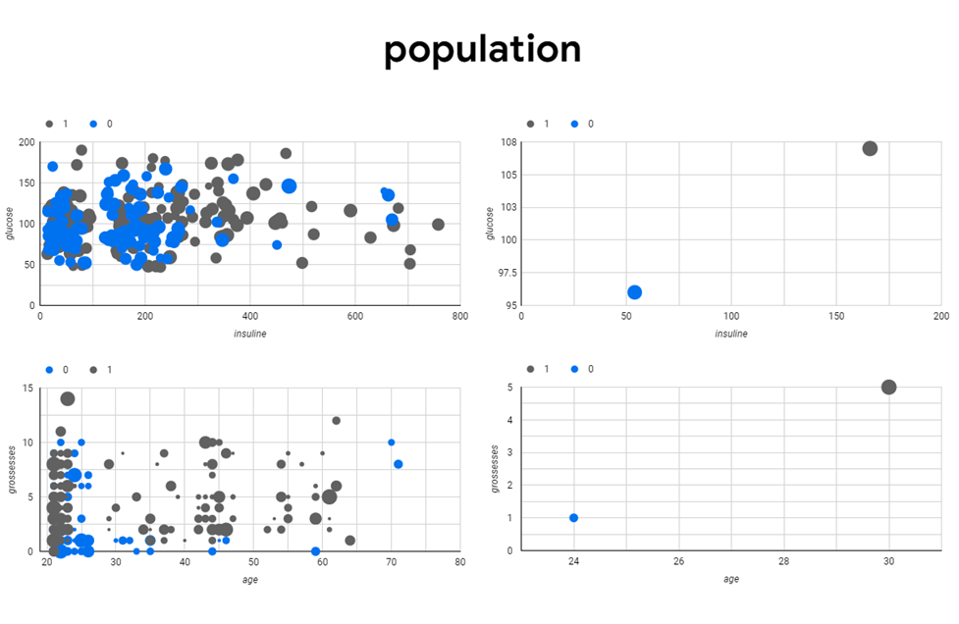
https://lookerstudio.google.com/s/hutQa9uTOE4

Slide 8
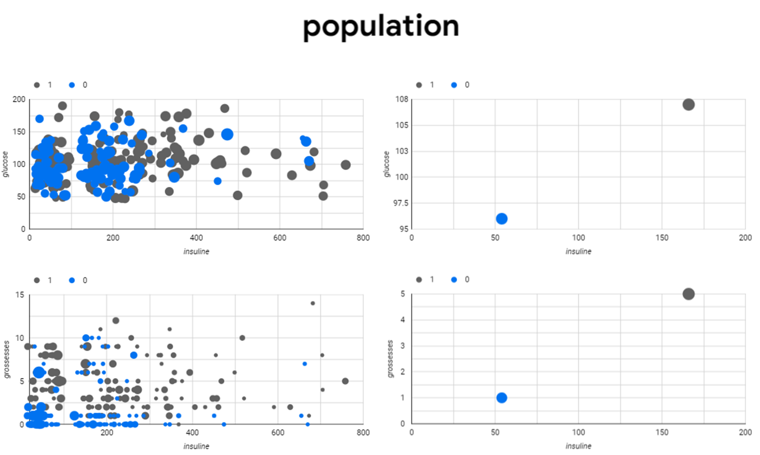
https://lookerstudio.google.com/s/hutQa9uTOE4

Slide 9
Logistic regression model
Classification Problem
Supervised Learning

Slide 10
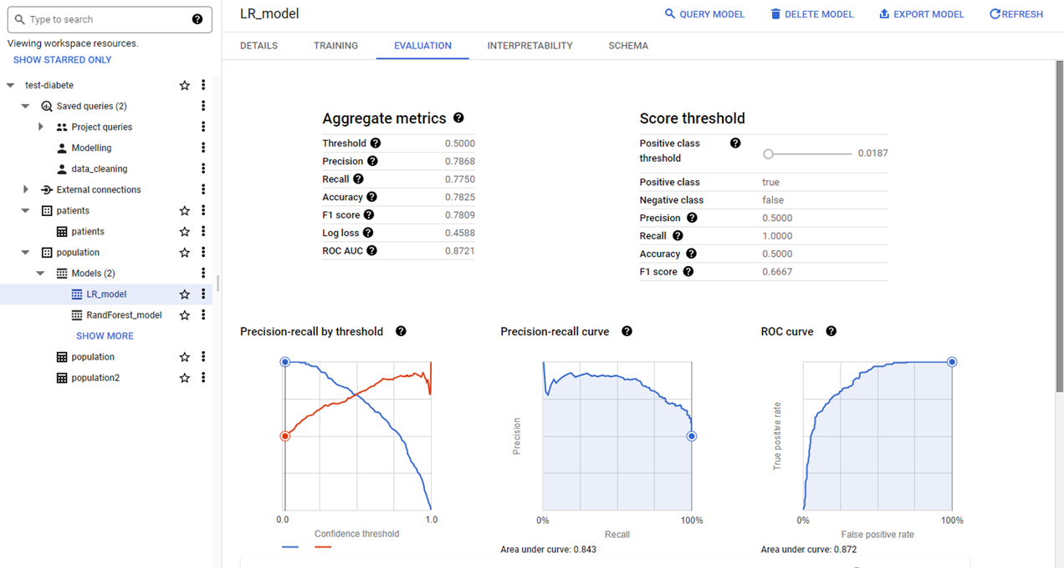
Summary metrics (1)

Slide 11
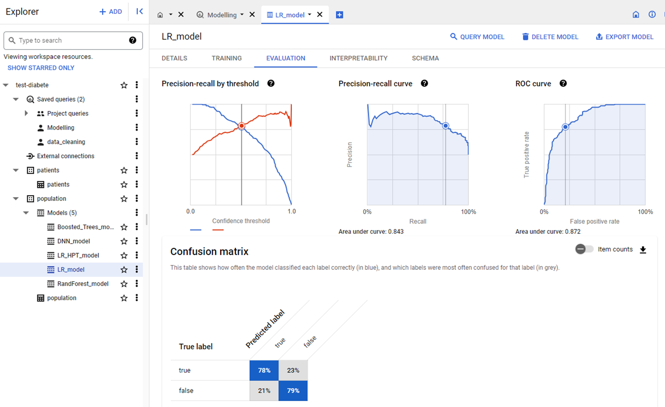
Summary metrics (2)

Slide 12
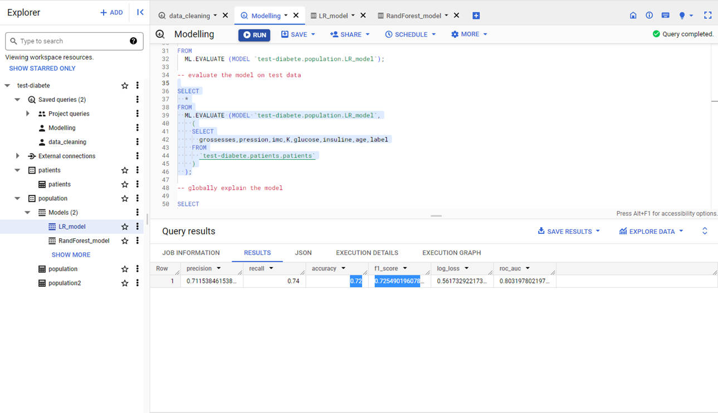
Summary metrics for Test data

Slide 13
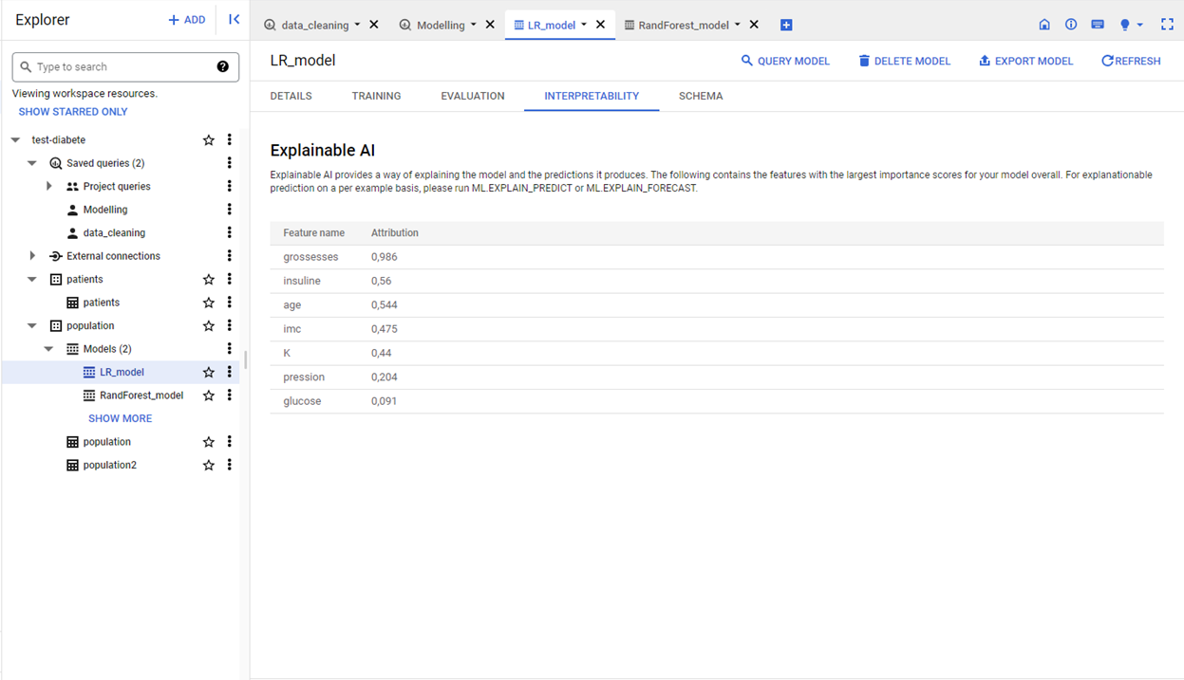
Features Importance

Slide 14
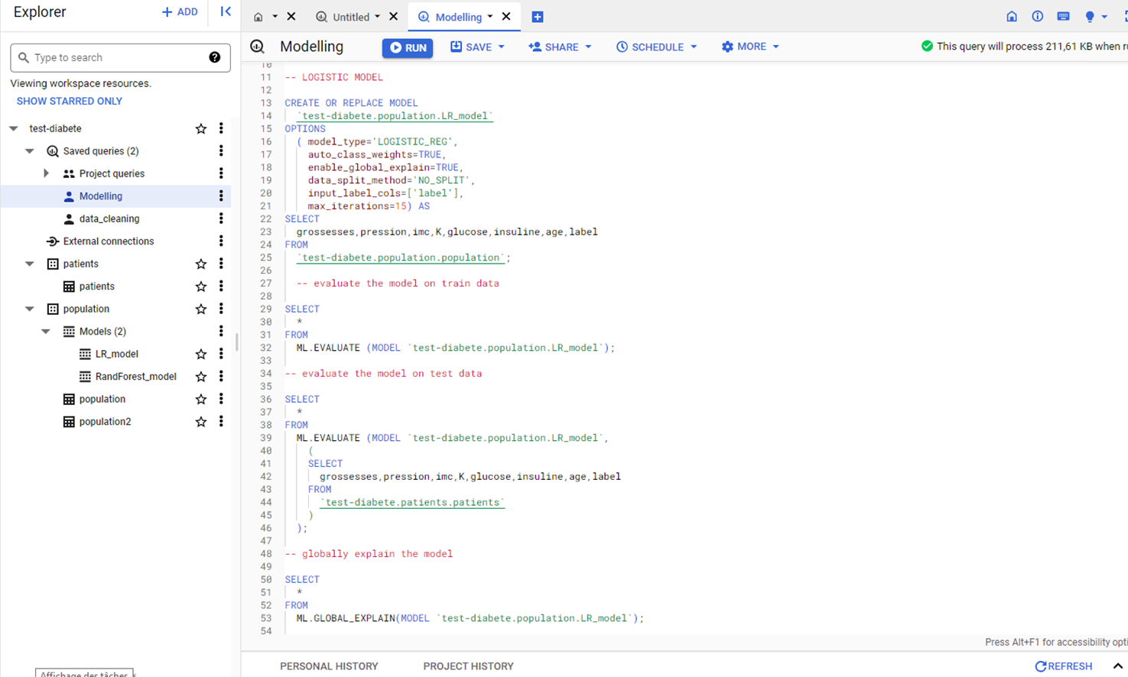
SQL code

Slide 15
Random Forest Classifier
Classification Problem
Supervised Learning

Slide 16
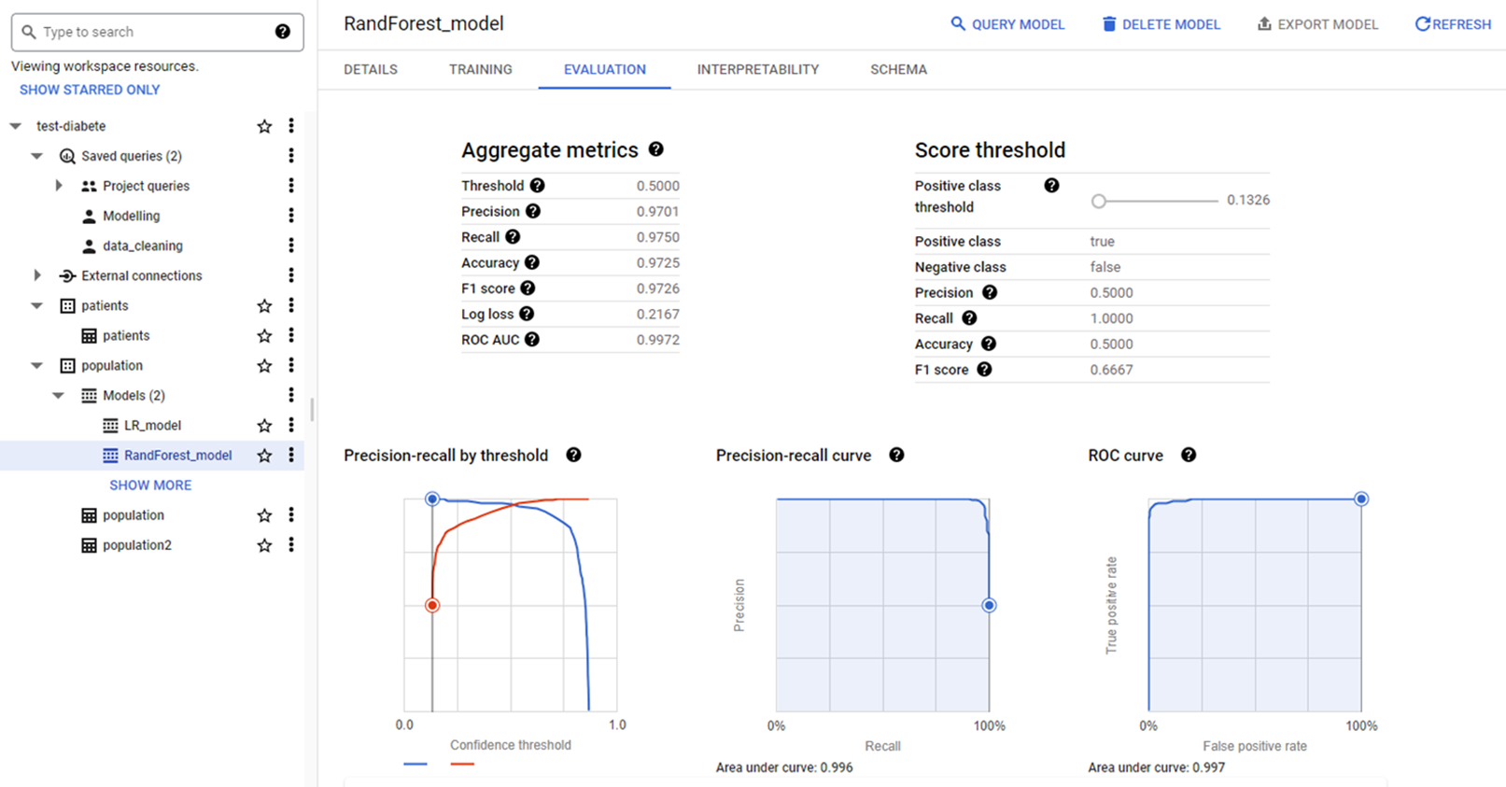
Summary metrics (1)

Slide 17
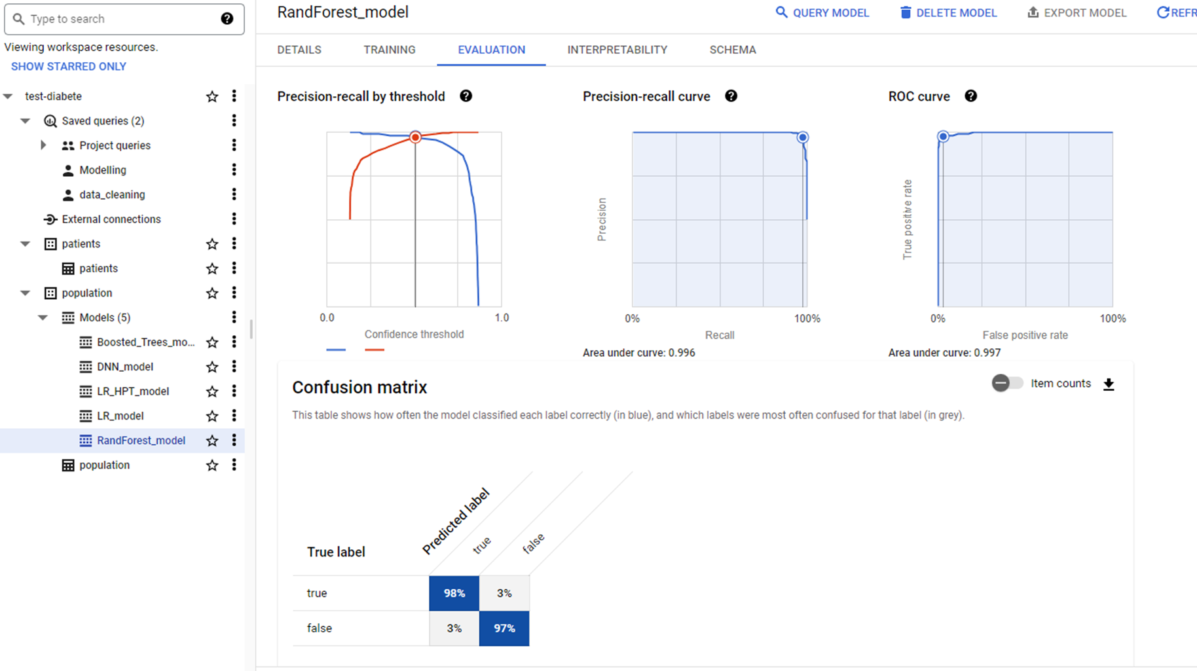
Summary metrics (2)

Slide 18
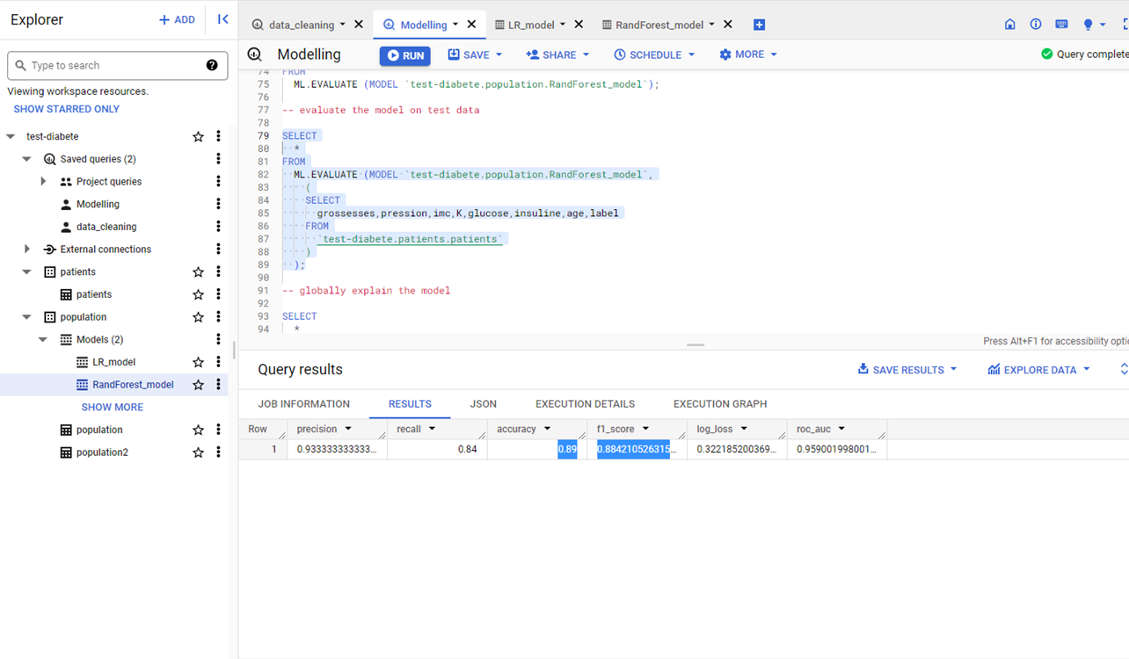
Summary metrics for Test data

Slide 19
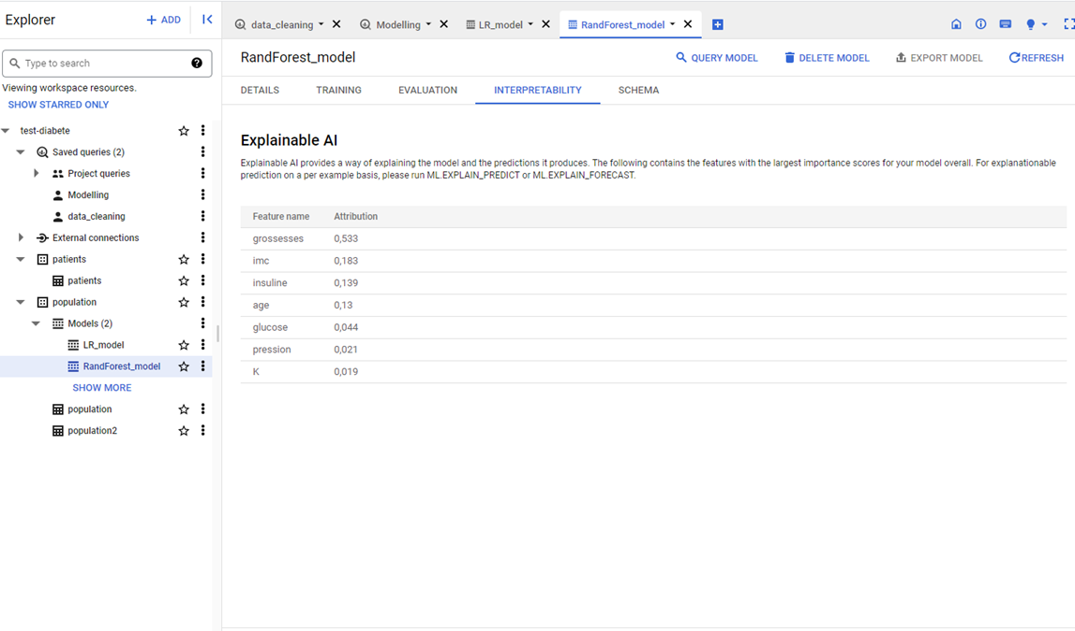
Features Importance

Slide 20
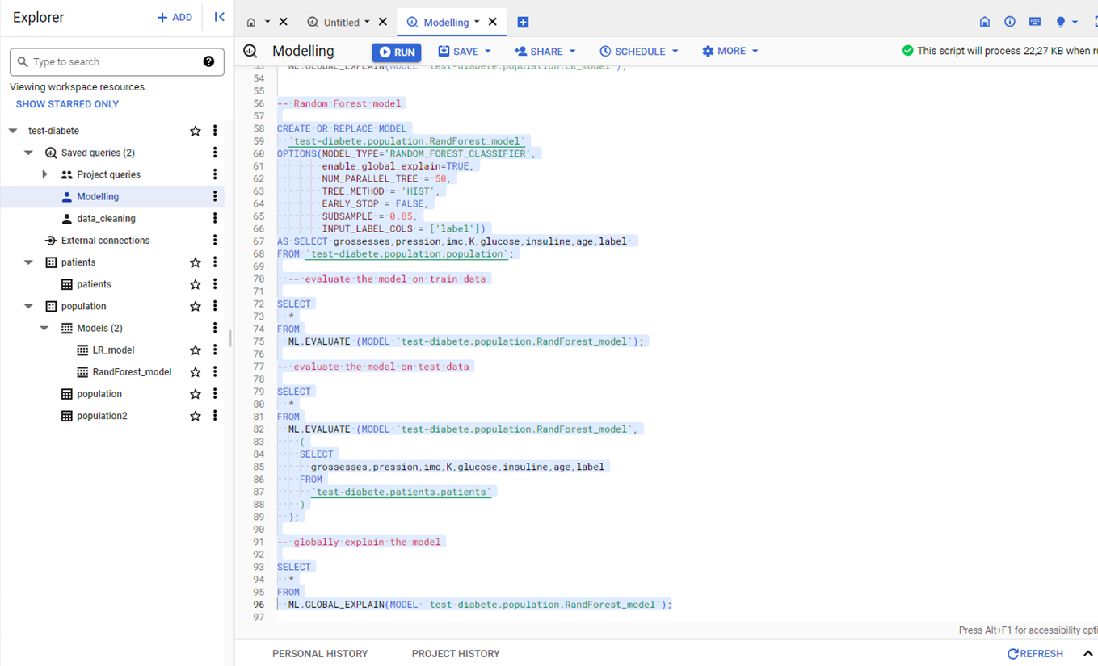
SQL code

Slide 21
Deep Neural Networks
Classification Problem
Supervised Learning

Slide 22
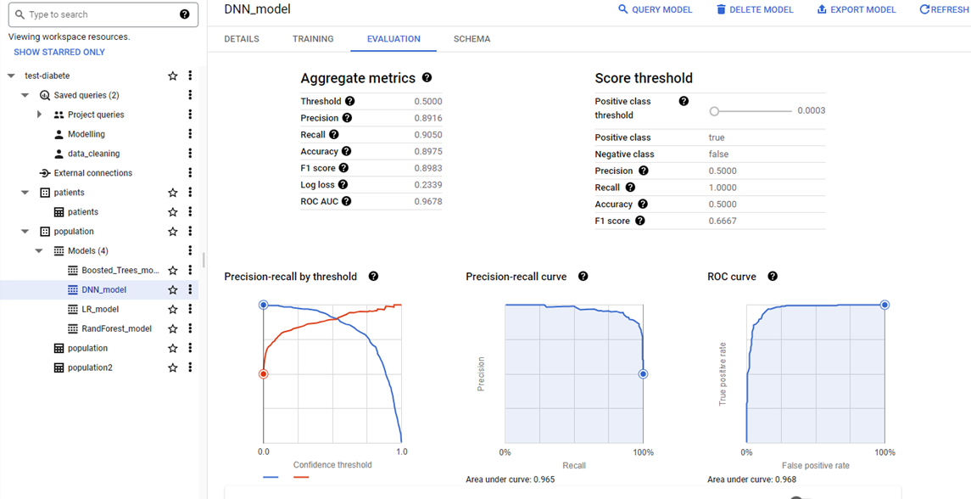
Summary metrics (1)

Slide 23
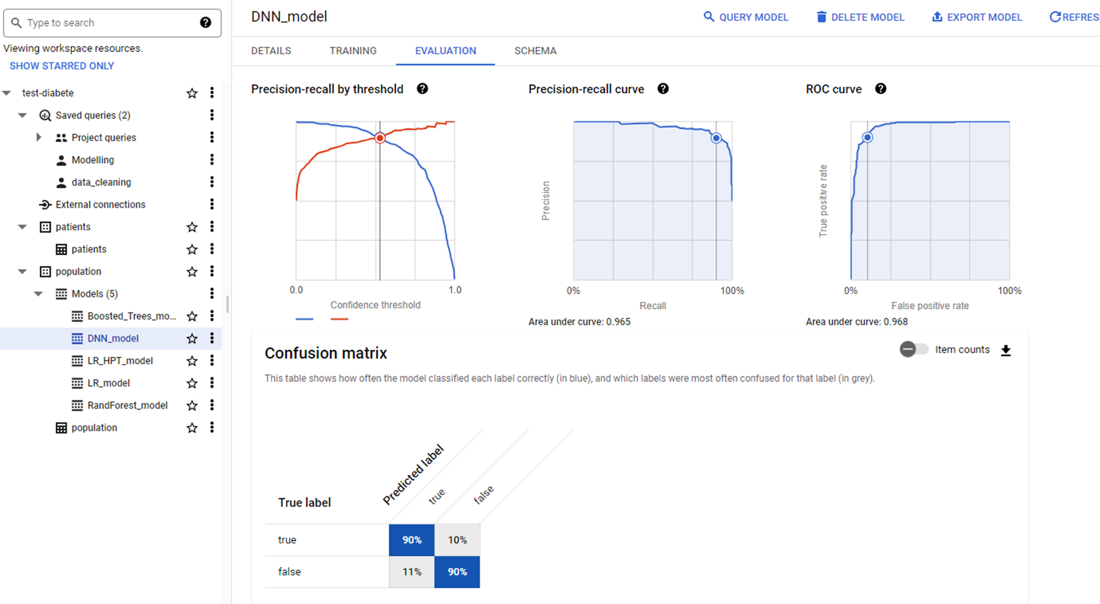
Summary metrics (2)

Slide 24
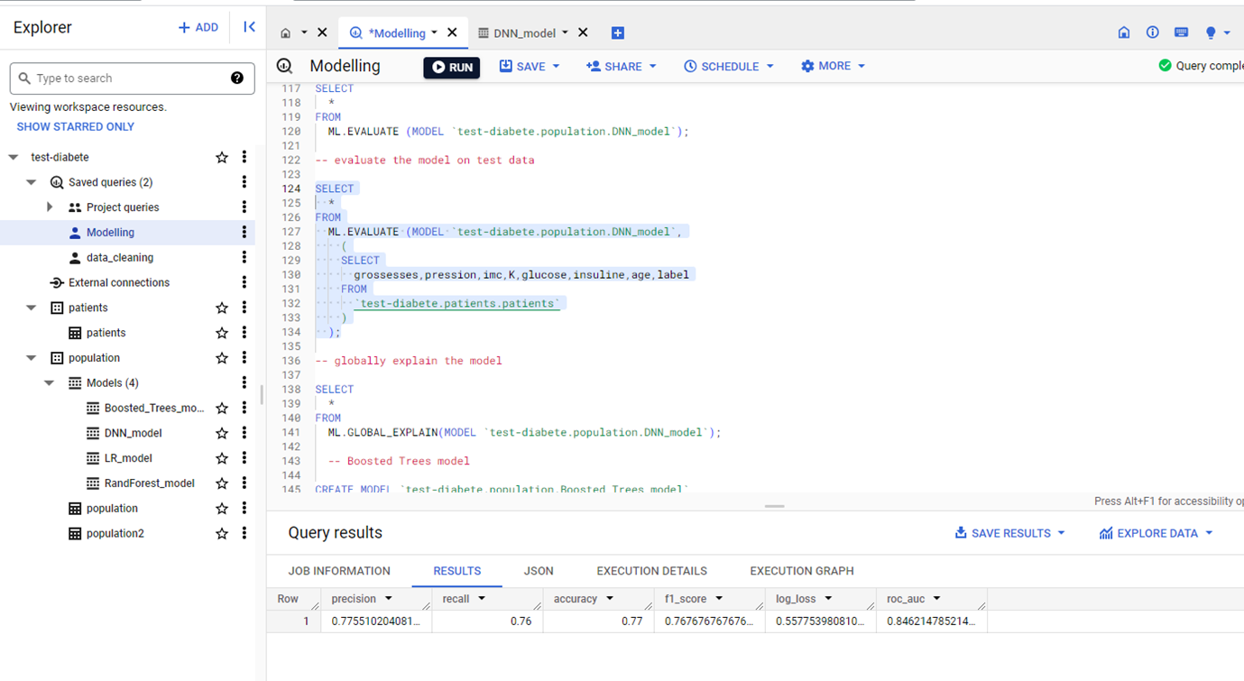
Summary metrics for Test data

Slide 25
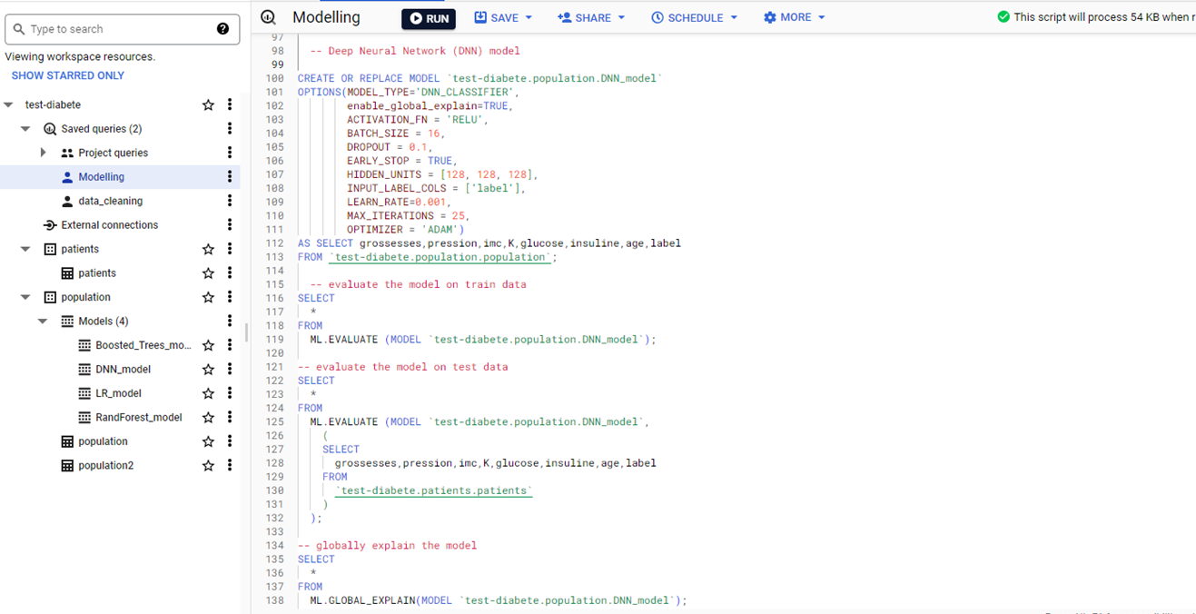
SQL code

Slide 26
Boosted Trees Classifier
Classification Problem
Supervised Learning

Slide 27
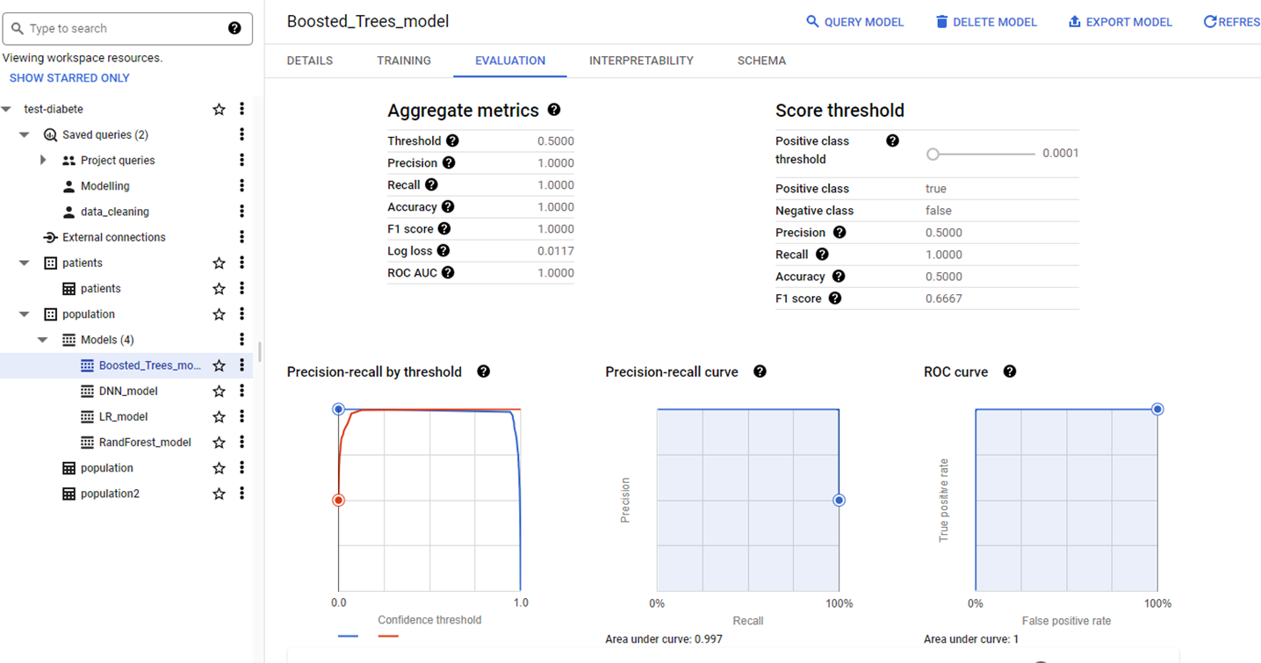
Summary metrics (1)

Slide 28
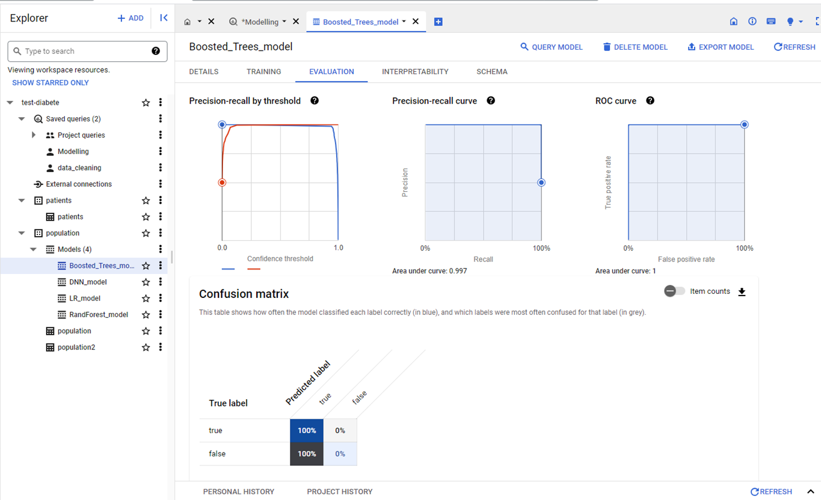
Summary metrics (2)

Slide 29
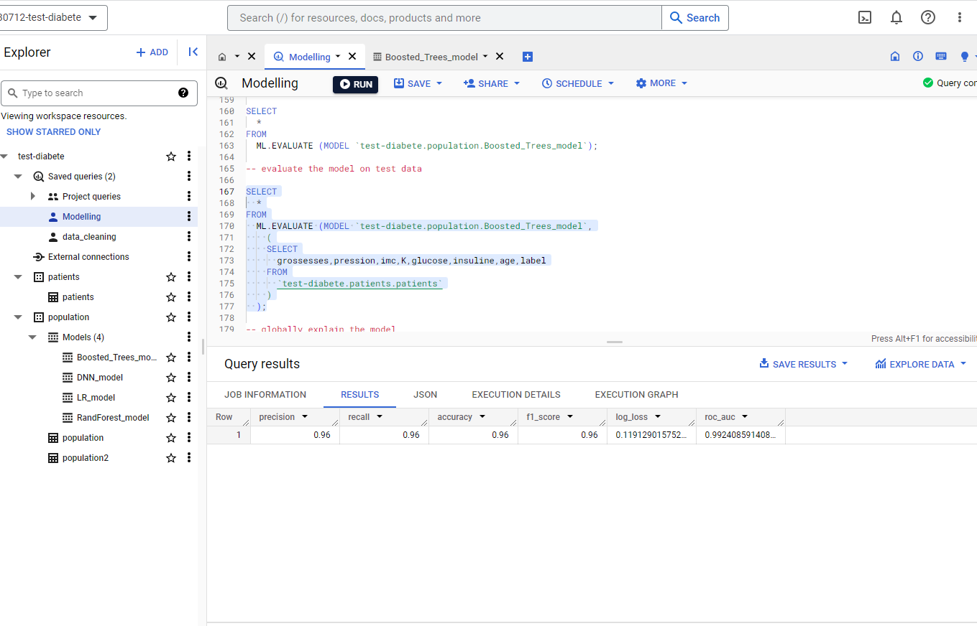
Summary metrics for Test data

Slide 30
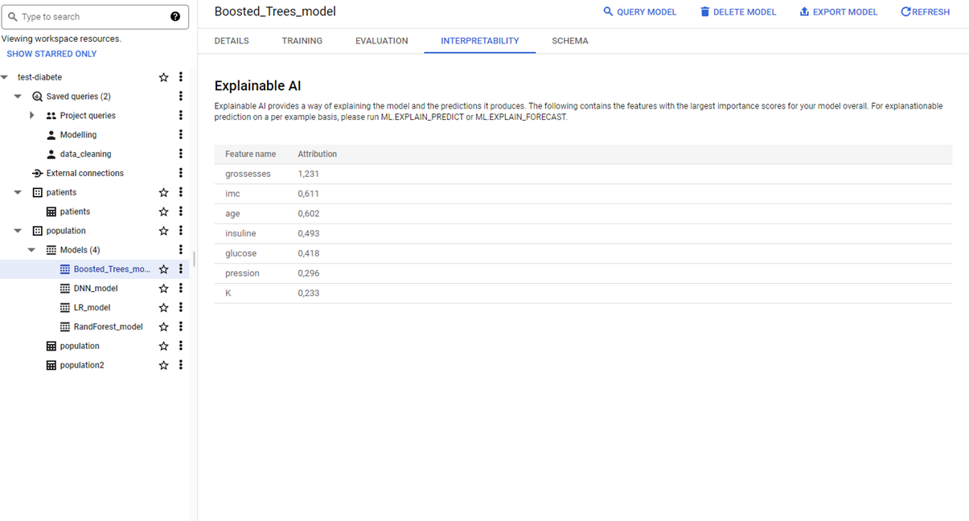
Features Importance

Slide 31
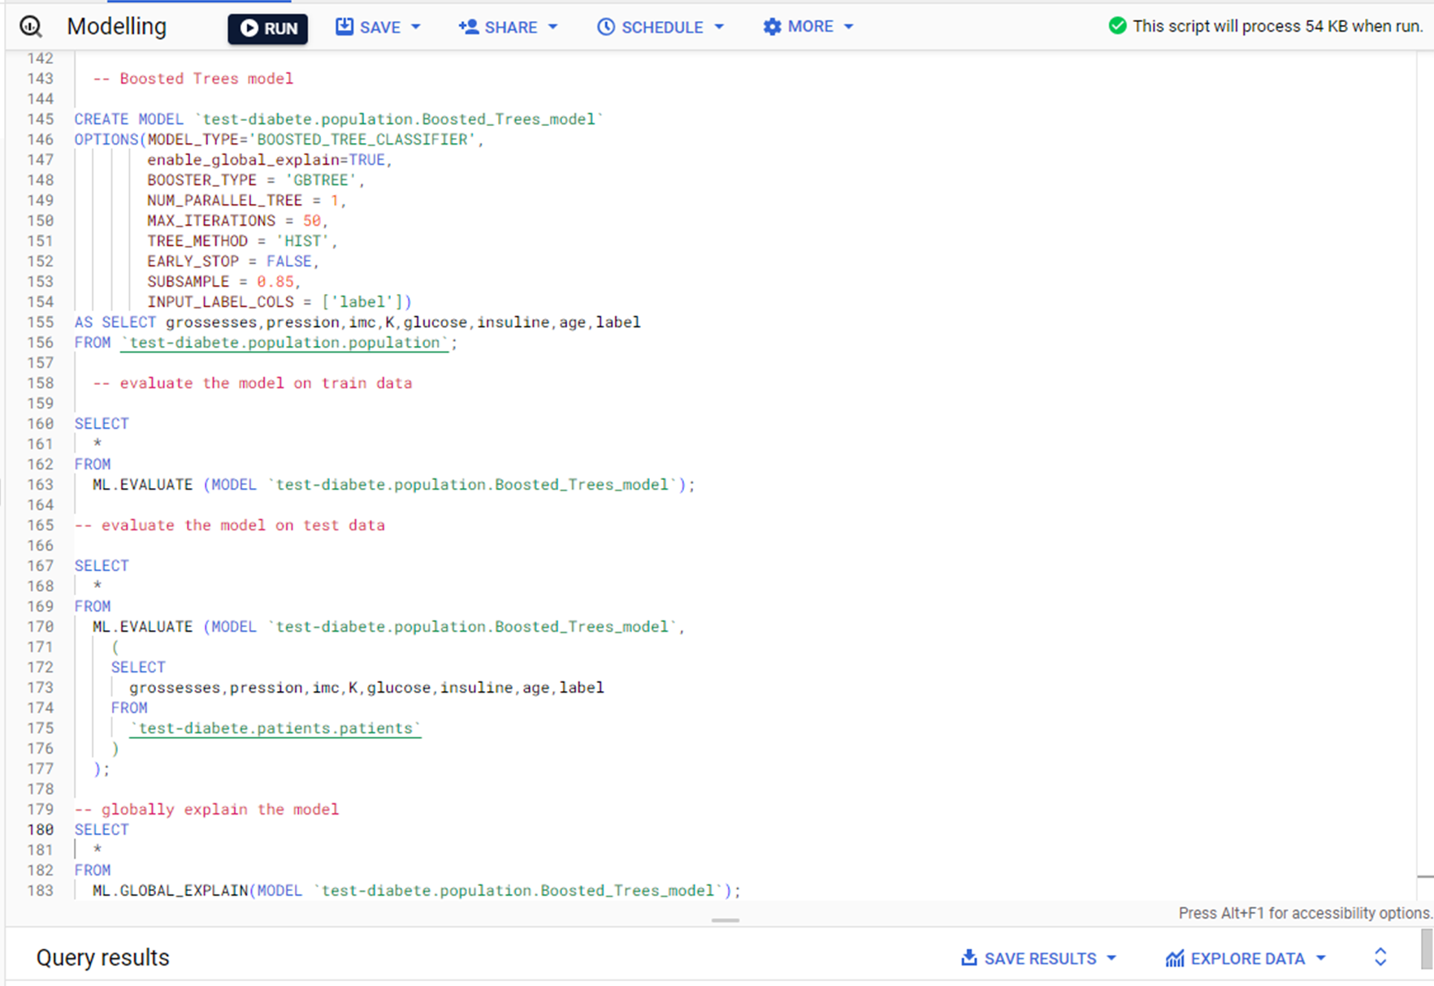
SQL code

Slide 32
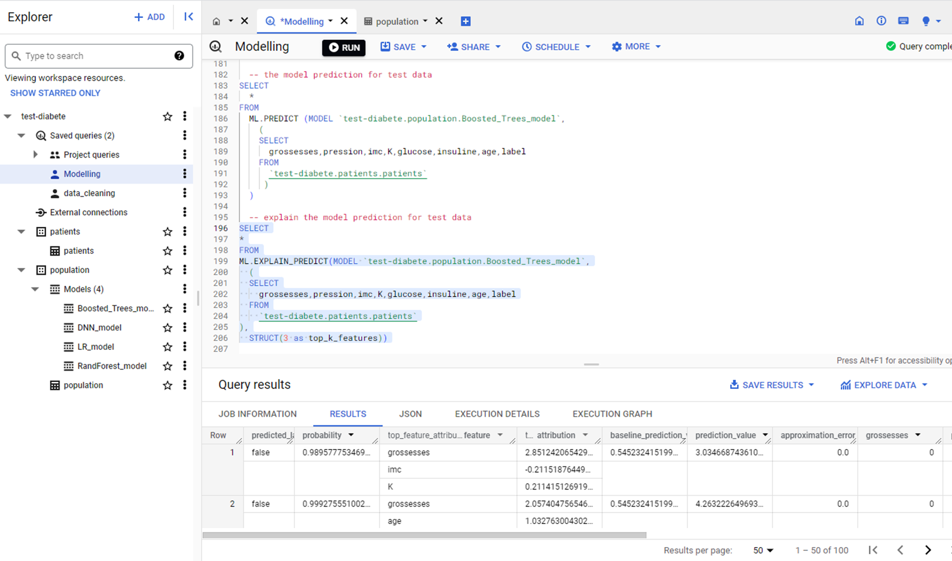
Prediction for test / SQL code

Slide 33
Hyperparameter Tuning
Example for a Logistic Regression model

Slide 34
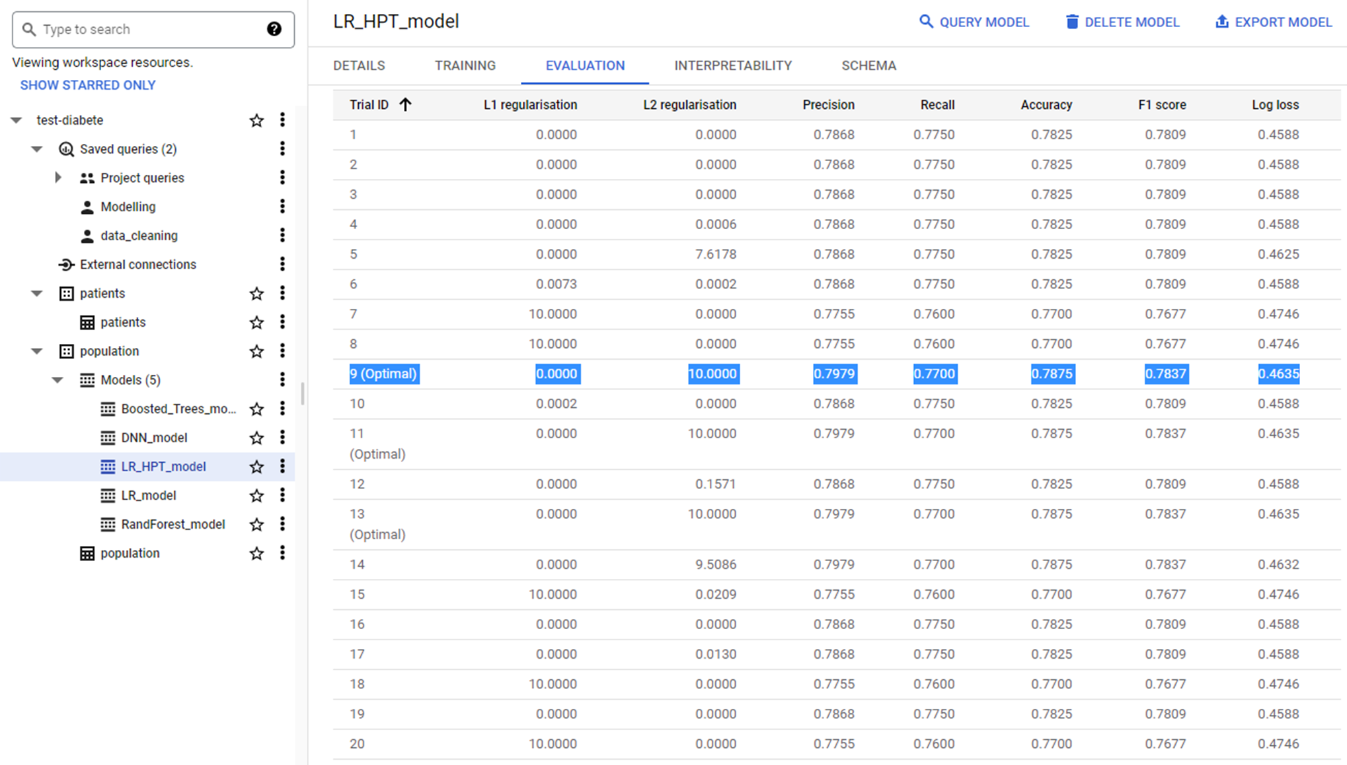
Evaluation Summary

Slide 35
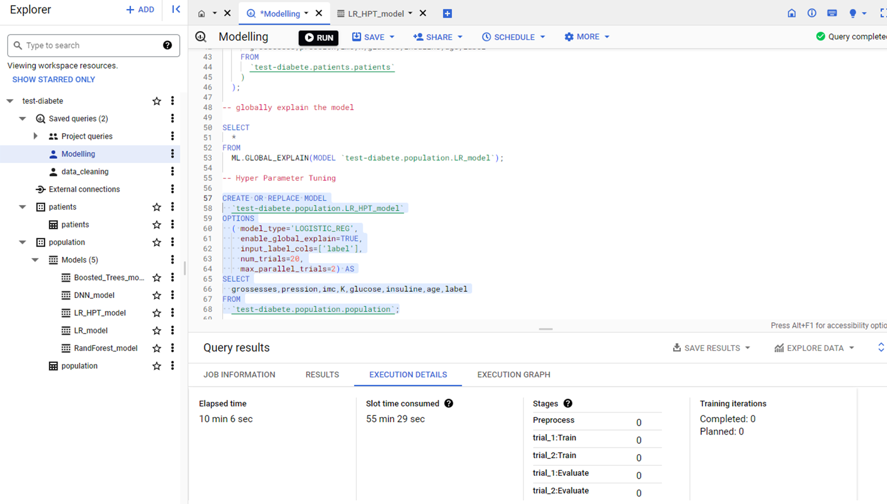
SQL code

Slide 36
Model deployment
Example for the Boosted Trees model

Slide 37
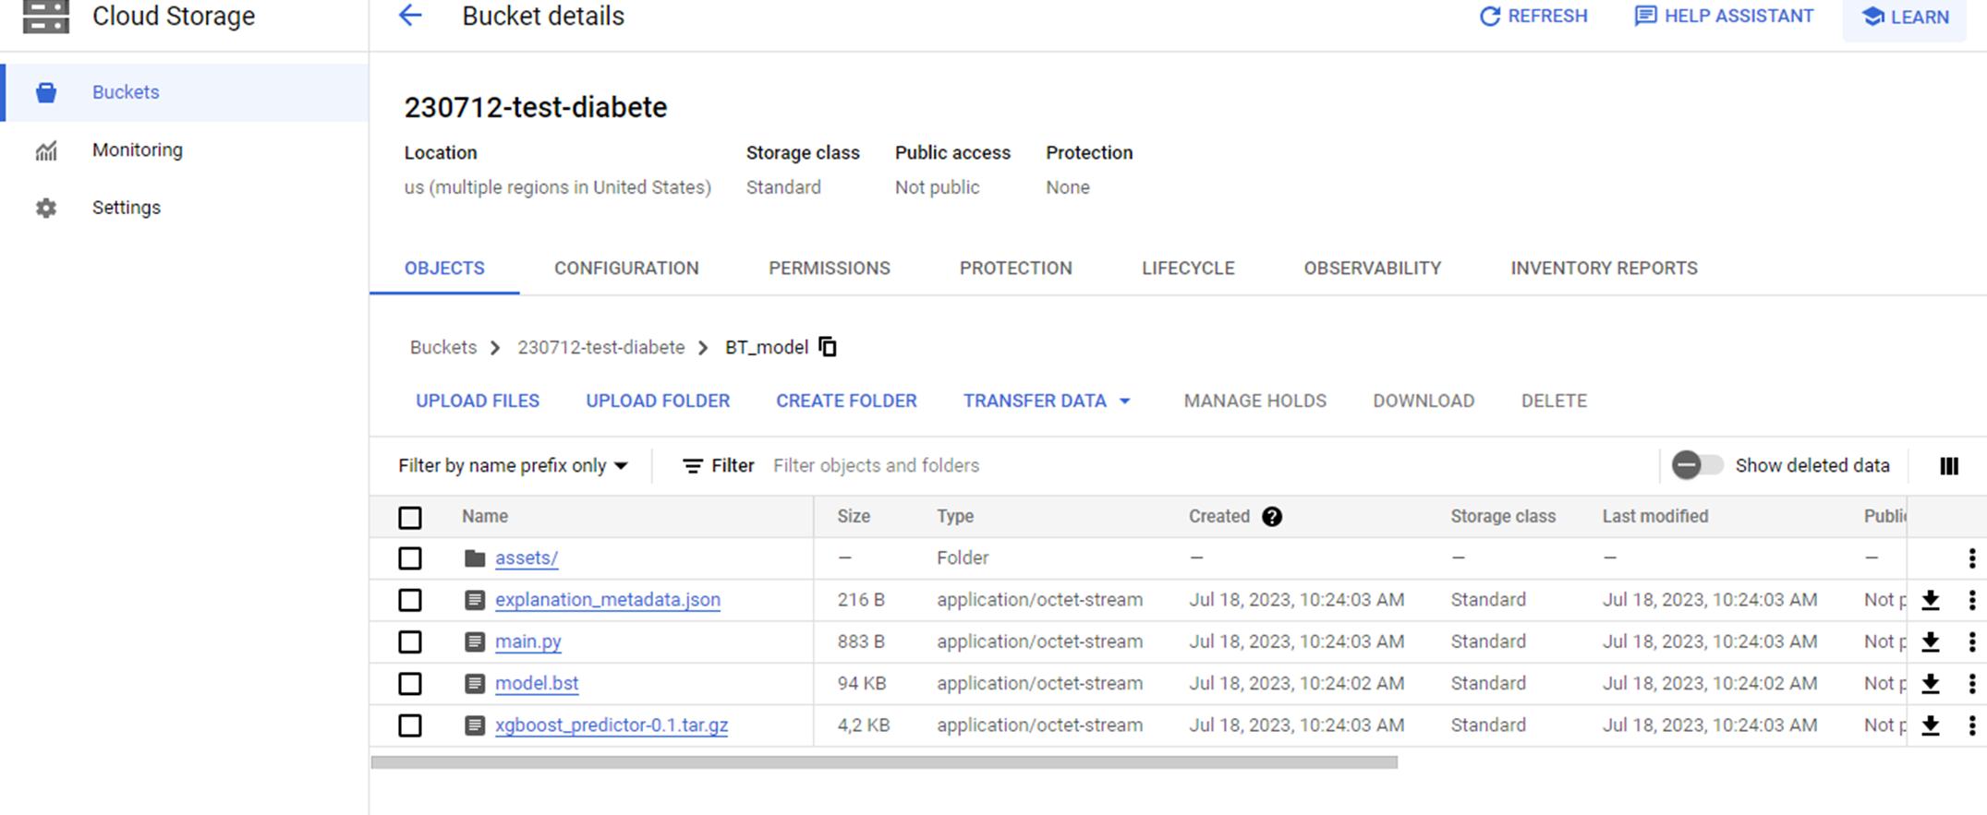
Export the model to the Bucket

Slide 38
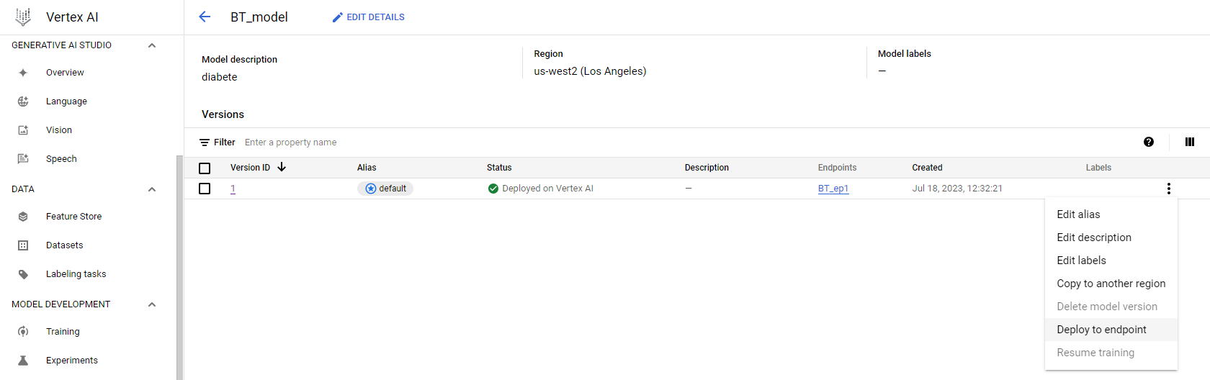
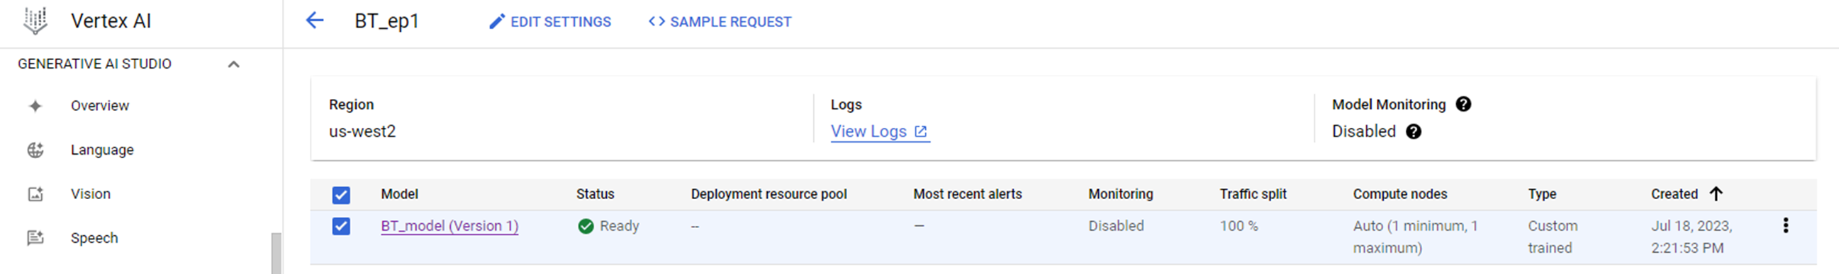
Register and Deploy the model

Slide 39
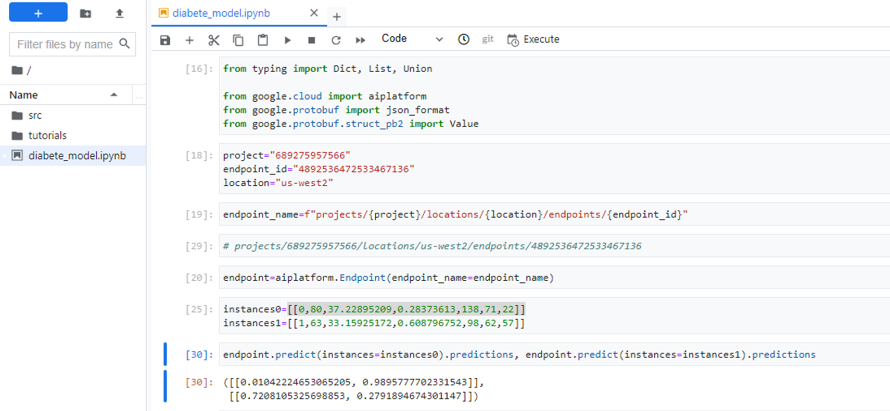
Workbench request

Slide 40
Summary / Key Learnings

Slide 41
Summary of models performance
Model | Accuracy / Train | Accuracy / Test
Logistic Regression / HPT | 0,78 / 0,80 | 0,72 / 0,71
Random Forrest Trees | 0,97 | 0,89
Deep Neural Network | 0,90 | 0,77
Boosted Trees | 1,00 | 0,96

Slide 42
Major points / technical
Data cleaning:
Manual cleaning for modelling is not necessary
BigQuery (BQ) ML automatically preprocesses data cleaning (imputation of missing values & data transformation (standardisation, encoding))
But the type of the missing value is to be NULL
BQ Looker gives a lot of possibilities to visualize data & make data stories
ML models make data transformation automatically, though it may be done manually
There is a possibility for Hyper Parameters Tuning to improve the models’ performance

